Slide 1
Cloud-native applications

Slide 2

Abstract and learning objectives
Abstract
This whiteboard design session is designed to help attendees understand the choices related to building and deploying containerized applications in Azure, critical decisions around this and other aspects of the solution including ways to lift-and-shift parts of the application to reduce applications changes.
Learning objectives
Work with Docker images and Azure Container Registry
Create a Kubernetes cluster with Azure Kubernetes Service (AKS)
Deploy containers to a Kubernetes cluster
Load balance containers, set up dynamic service discovery
Scale services
Perform rolling upgrades with zero downtime

Slide 3
Step 1: Review the customer case study
Outcome
Analyze your customer needs.
Timeframe
15 minutes

Slide 4
Customer situation
Fabrikam Medical Conferences provides conference web site services tailored to the medical community.
After starting with a few small conferences, they now have evolved into a well-known brand and handle over 100 conferences per year, and growing.

Slide 5
Customer situation
Each conference site has limited budget, but the conference owners have significant customization and change demands.
These changes can impact various aspects of the system from UI to back end, including conference registration and payment terms.

Slide 6
Customer situation
12 developers handle
Development
Testing
Deployment
Operational management of all customer sites
Due to customer demands, they have issues with the efficiency and reliability of their development and DevOps workflows.

Slide 7
Customer situation
The technology used is the MEAN stack
Mongo, Express, Angular, and Node.js
Conference sites are currently hosted on Windows Server machines on premise.
The data back-end is a MongoDB cluster also deployed to Windows Server machines on premise.

Slide 8
Customer situation
Conference owners (“customers”) are considered “tenants”, and each tenant is treated as a unique deployment including:
A database in the MongoDB cluster with its own collections
A copy of the most recent functional conference code base is taken and configured to point at the tenant database
Modifications are made to support the customer’s needs
The tenant’s code is deployed to a specific group of load balanced Windows Server machines dedicated to one or more tenant.
Once the conference site is live, the inevitable requests for customizations to the deployment begins.

Slide 9

Customer situation
They are looking to achieve the following:
Reduce potential regressions introduced to functional tenant code when changes are made
Ideally, changes to individual areas should not require a full regression test of the site functionality
Reduce the time to onboard new tenants
Reduce overhead managing changes, and related deployments
Improve ability to roll back and recover post change
Increase visibility into system operations and health

Slide 10
Customer needs
Simplify new tenant deployment
Improve reliability of tenant updates
Choose a suitable Docker container strategy on Azure
Migrate MongoDB data to Cosmos DB without application changes
Continue to use Git repositories for source control
Look at Azure DevOps as the CICD tool of choice
Use tools for deployment, CICD integration, container scheduling, orchestration, monitoring, and alerts
They wish to complete an implementation of the proposed solution for a single tenant to train the team and perfect the process

Slide 11

Customer objections
There are many ways to deploy Docker containers on Azure, how do those options compare and what are motivations for each?
Is there an option in Azure that provides container orchestration platform features that are easy to manage and migrate to, that can also handle our scale and management workflow requirements?

Slide 12
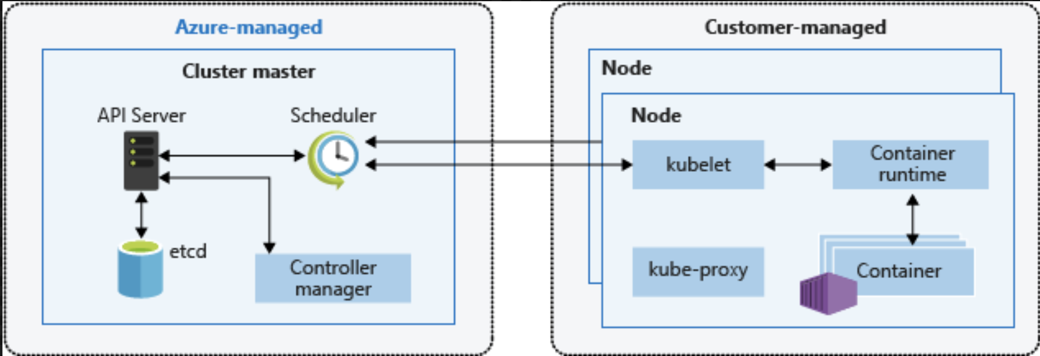
Common scenarios
Kubernetes Architecture

Slide 13
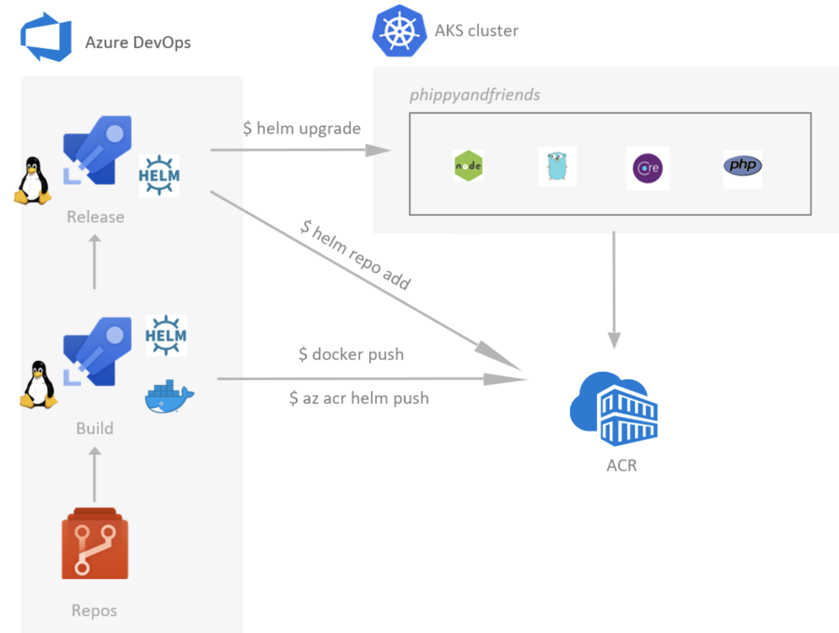
Common scenarios
Azure DevOps for CICD to Azure Kubernetes Service (AKS)

Slide 14
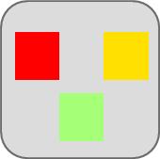

Traditional application approach
Microservices application approach
A traditional application has most of its functionality within a few processes that are componentized with layers and libraries.
Scales by cloning the app on multiple servers/VMs
App 1
A microservice application segregates functionality into separate smaller services.
Scales out by deploying each service independently with multiple instances across servers/VMs
App 1
App 2
Independent deployment and scale of microservices
Coarse-grained density of apps/services
Fine-grained density of services
Need to deploy and scale the full application

Slide 15
Step 2: Design the solution
Outcome
Design a solution and prepare to present the solution to the target customer audience in a 15-minute chalk-talk format.
Timeframe
60 minutes
Business needs (10 minutes) | Respond to questions outlined in your guide and list the answers on a flipchart.
Design (35 minutes) | Design a solution for as many of the stated requirements as time allows. Show the solution on a flipchart.
Prepare (15 minutes) | Identify any customer needs that are not addressed with the proposed solution. Identify the benefits of your solution. Determine how you will respond to the customer’s objections. Prepare for a 15-minute presentation to the customer.

Slide 16
Step 3: Present the solution
Outcome
Prepare to present a solution to the target customer in a 15-minute chalk-talk format.
Timeframe
30 minutes (15 minutes for each team to present and receive feedback)
Directions
Pair with another table.
One table is the Microsoft team and the other table is the customer.
The Microsoft team presents their proposed solution to the customer.
The customer asks one of the objections from the list of objections in the case study.
The Microsoft team responds to the objection.
The customer team gives feedback to the Microsoft team.

Slide 17
Wrap-up
Outcome
Identify the preferred solution for the case study.
Identify solutions designed by other teams.
Timeframe
15 minutes

Slide 18

Preferred target audience
Arthur Block, VP Engineering at Fabrikam Medical Conferences
The primary audience is the technical strategic decision-maker with influential solution architects, or lead technical personnel in development or operations .
Usually we talk to the key architects, developers and infrastructure managers who report to the CIO or equivalent, or to key solution sponsors or those that represent the business unit IT or developers that report to those sponsors.
Notes:
The primary audience is the technical strategic decision-maker with influential solution architects, or lead technical personnel in development or operations.
For this example this could include the VP Engineering and his core team.

Slide 19
Preferred solution
After evaluating the options for container platforms on Azure, Fabrikam Medical Conferences decided to move forward with Azure Kubernetes Service (AKS).
They also decided to move forward with Azure DevOps for infrastructure and container DevOps workflows.

Slide 20
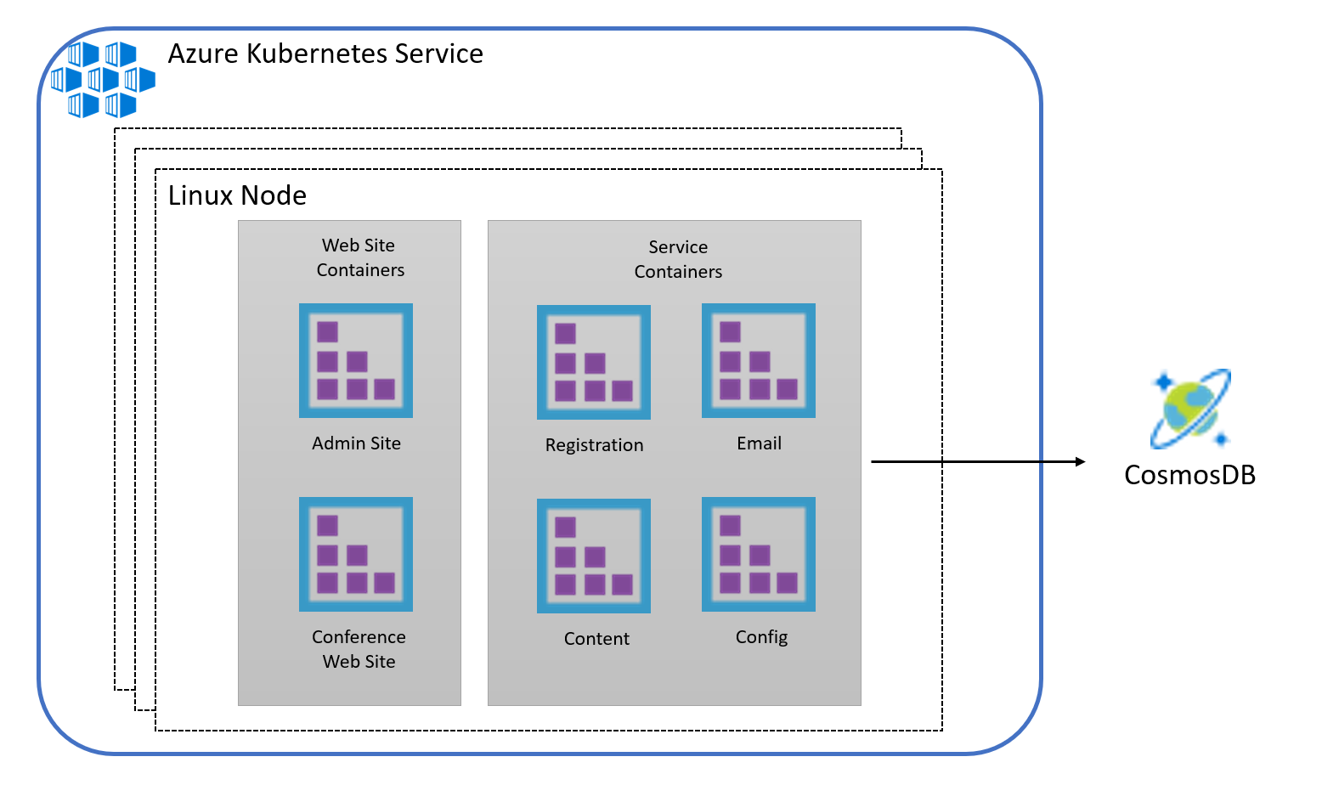
Preferred solution

Slide 21
Microservices key concepts
In the next few slides, we will discuss best-practices for building microservices-based applications for broader scenarios. Key concepts:
Bounded contexts
Publish/subscribe channels (event bus)
Direct communication vs. API Gateway

Slide 22
Bounded contexts and microservices
Bounded context == “Business microservice” boundary
Each Bounded Context has:
- Its own Domain Model → i.e. Database/tenant/container
- Its own context, invariants, rules, code!
- IT IS AUTONOMOUS!

Slide 23
Business/Logical microservices (bounded contexts)
Example 1
Example 2
Catalog “business” microservice
Ordering “business” microservice
Business/logical
microservice
SQL Server/Cosmos DB database
Ordering.API
Gateway
service
Web API
SQL Server/ Cosmos DB
database
GracePeriod
Stateful service
partitions
Worker Svc.
Partition
A
Partition
n
(Using Azure Service Fabric Stateful Reliable Services)
The Logical Architecture can be different to the Physical/Deployment Architecture
A Bounded Context can be implemented by 1 or more services (i.e. Docker containers, Azure Functions, ASP.NET Web API, etc.)

Slide 24
Identifying a domain model per microservice/bounded context
Orders and Registration
Conferences Management
Conferences
Buyers
Organizers
Conferences
Seats
Seats
Attendees
Companies
Country
Orders
Reservation
Users
Attendees
Seats Assignments
Pricing and Marketing
Payment
Customer Service
Conferences
Payers
Customers
Promotions
Payments
Returns
Seats
External Gateways
…

Slide 25
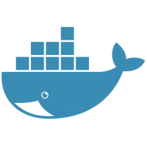
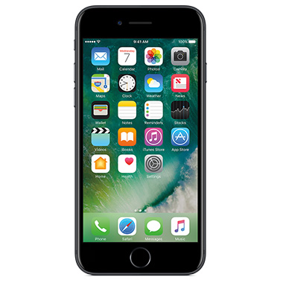

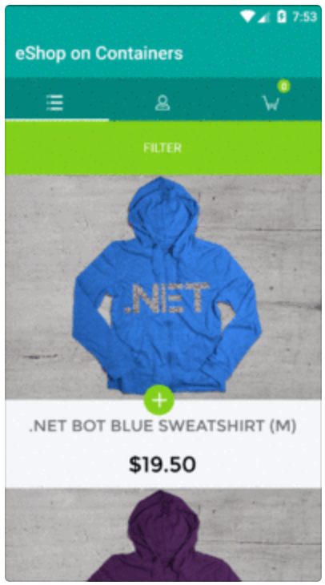
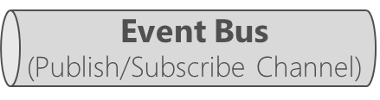
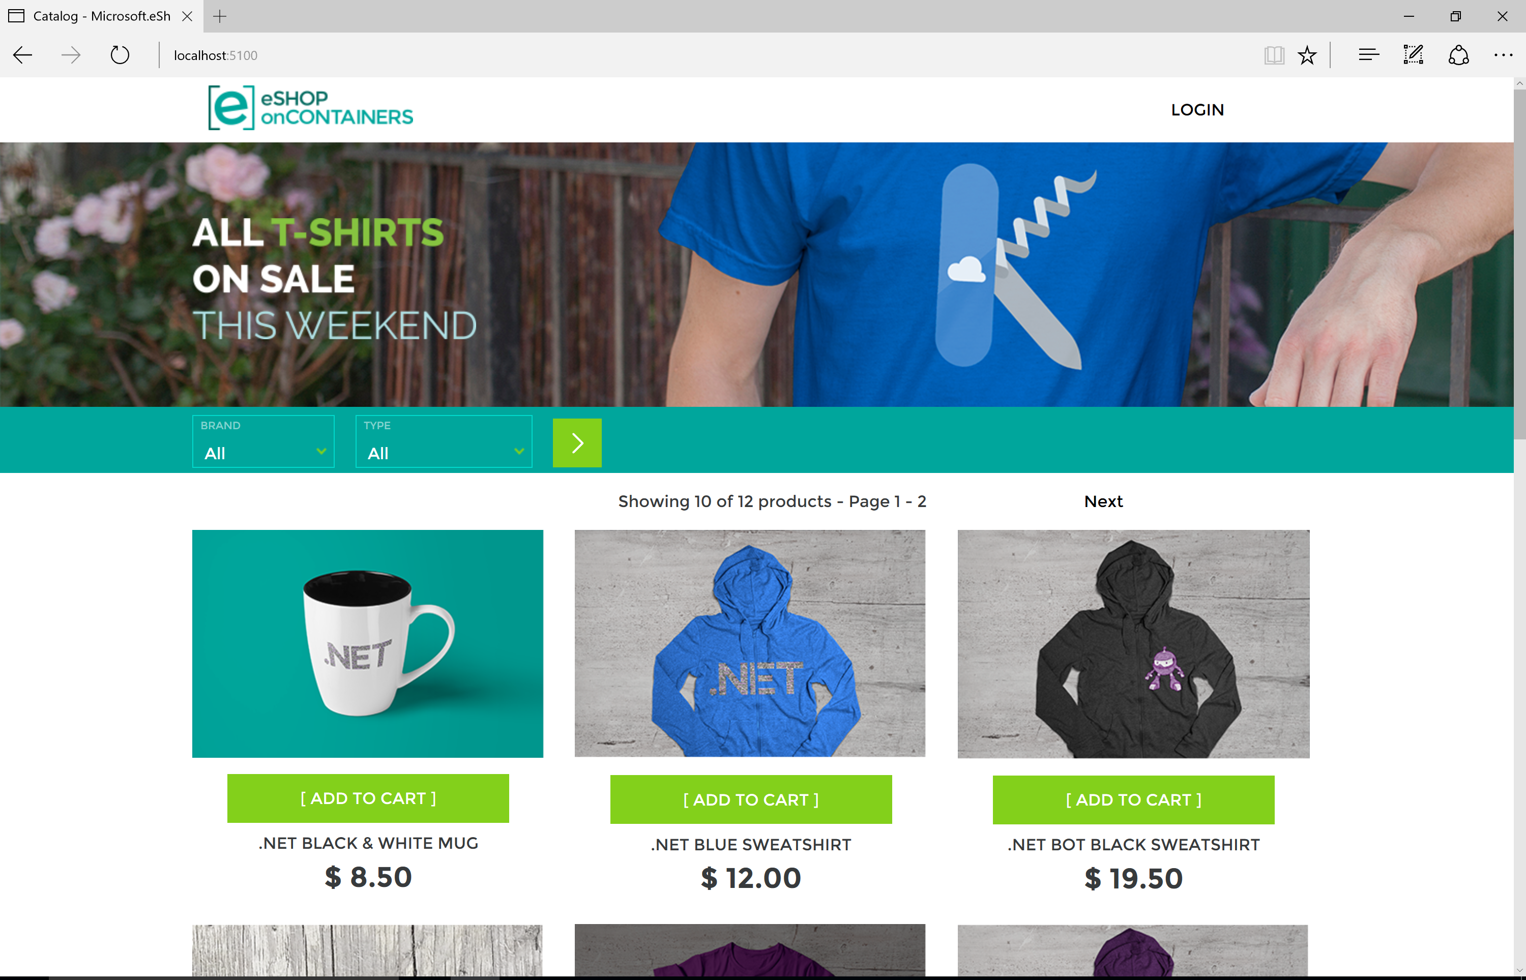



eShopOnContainers Reference Application - Architecture
Client apps
Docker Host
Identity microservice (STS+users)
eShop mobile app
SQL Server db
Xamarin.Forms
C#
xPlat. OS:
iOS
Android
Windows
Catalog microservice
SQL Server db
Ordering microservice
eShop traditional Web app
eShop WebApp MVC
Ordering.API
SQL Server db
ASP.NET Core MVC
GracePeriod worker Svc.
Basket microservice
HTML
Redis cache
eShop SPA Web app
Marketing microservice
MongoDB /
CosmosDB
SQL Server DB
TypeScript/Angular 4
Location microservice
MongoDB /
CosmosDB
Notes:
This slide shows how each microservice has its own data source/sink. An event bus is used as a publish/subscribe (pub/sub) channel to facilitate indirect communicaton between the microservices.

Slide 26
Asynchronous Event-Driven communication with an Event Bus
Backend
Basket Microservice
Database as
Cache
User-Profile Microservice
Service
1
Web API Service
3
UserUpdated event → Buyer info
UpdateUser
command
Event Bus
(Publish/Subscribe Channel)
UserUpdated event
(Publish Action)
4
2
UserUpdated event → Buyer info
DB update
Event Bus Abstractions/Interface
Ordering Microservice
Database
Event Bus Implementations
Azure
Service
Bus
Other:
NServiceBus
MassTransit
etc.
Database
RabbitMQ
Service
Eventual consistency across microservices’ data based on event-driven async communication
The Cosmos DB change feed can be used as an event source for one or more subscribers, enabling event-driven asynchronous communication in the reference architecture

Slide 27
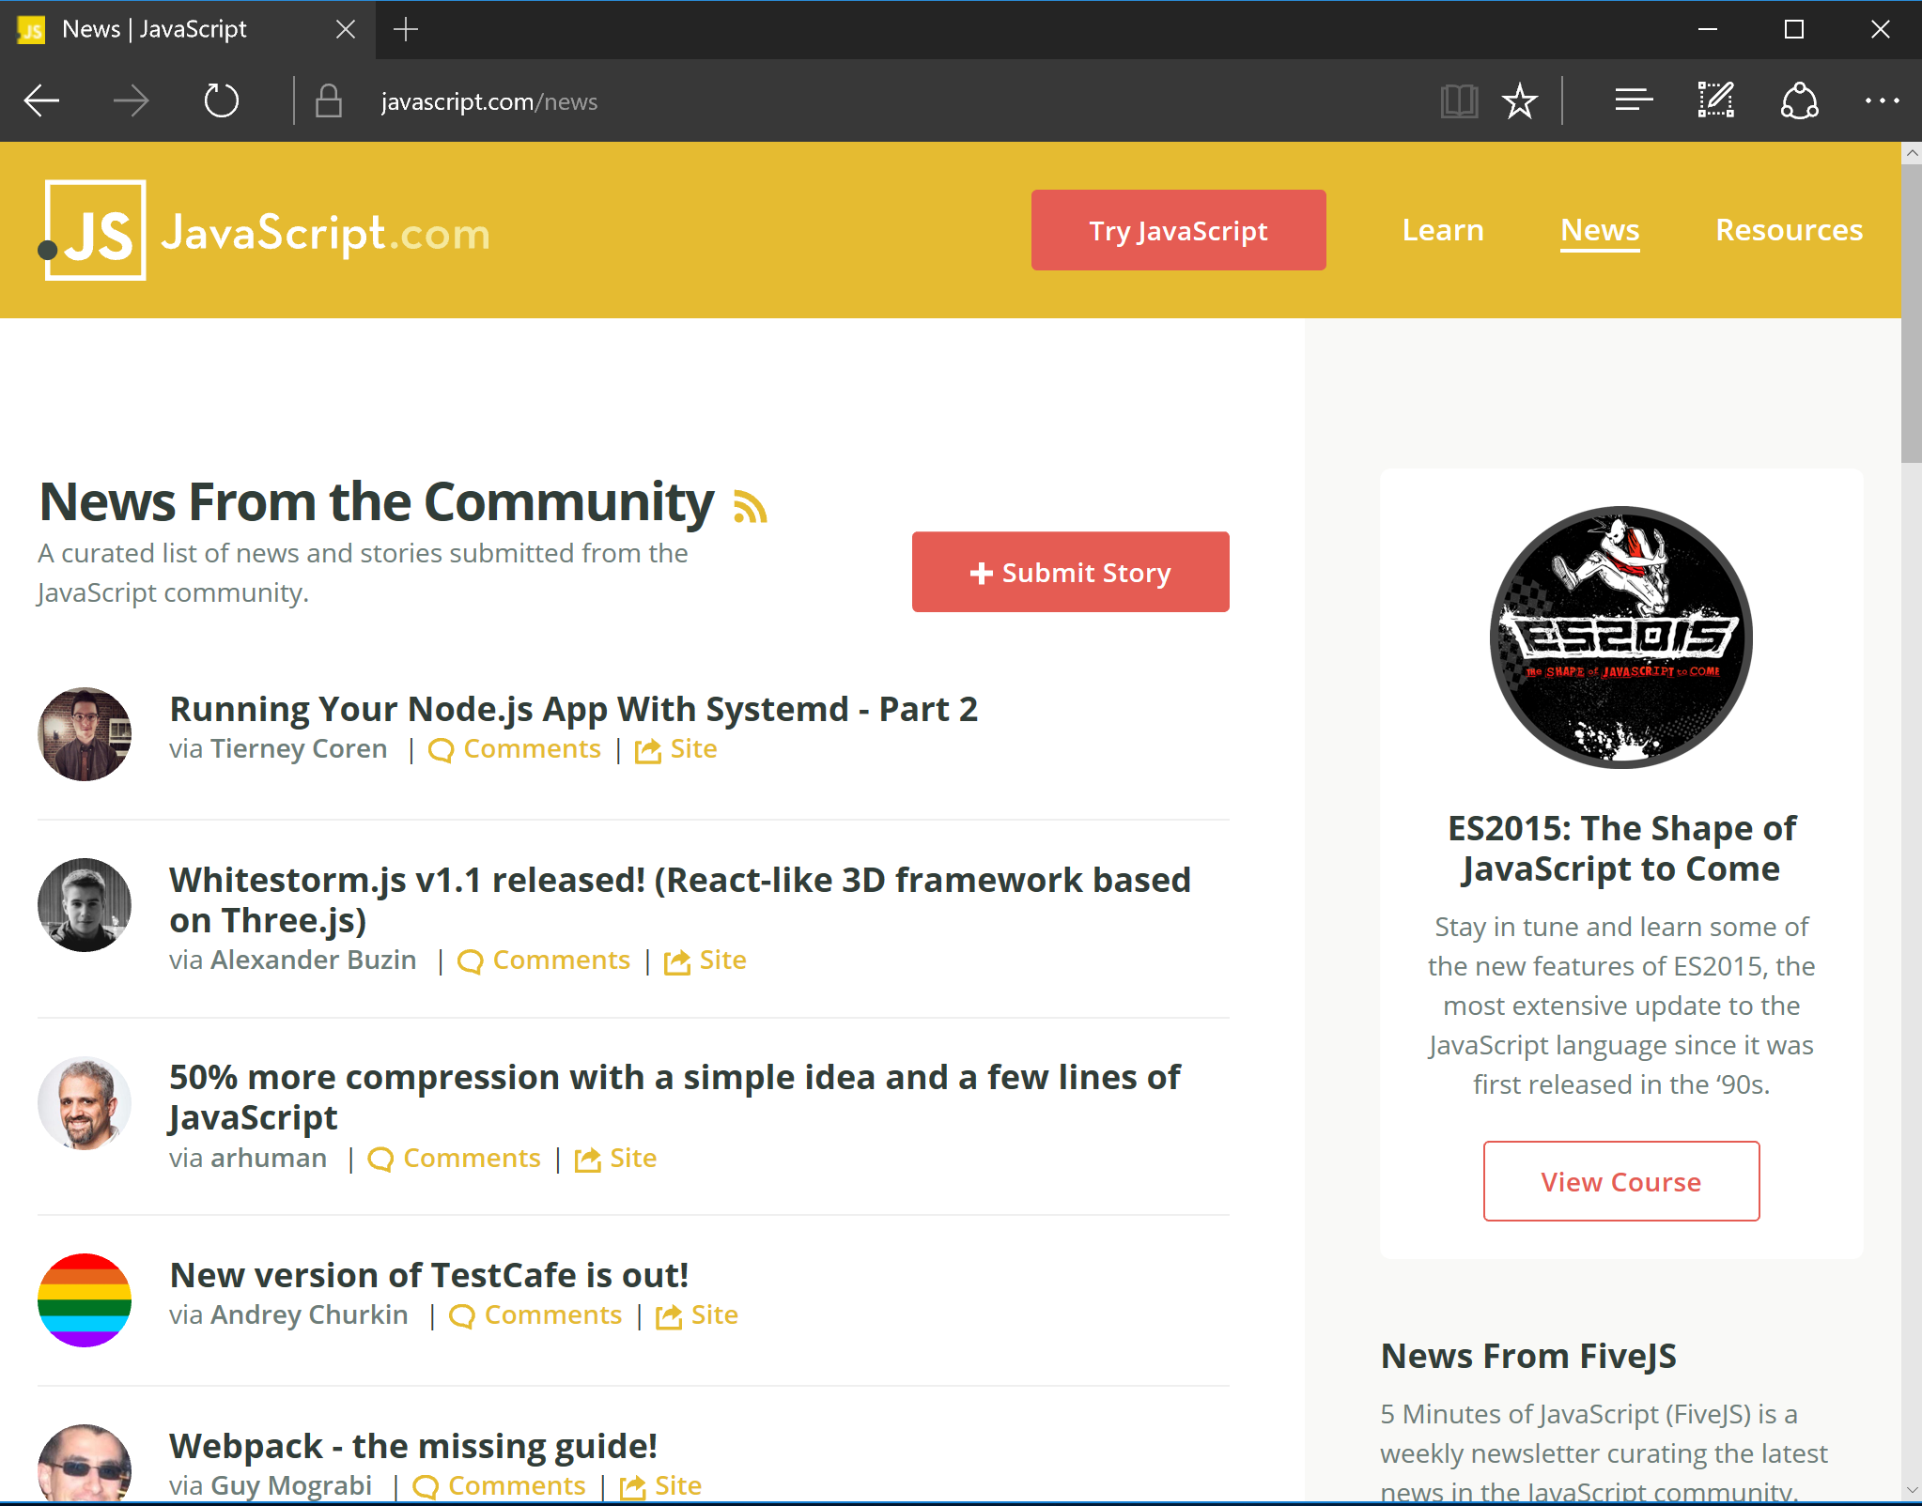
Direct client-to-microservices communication
Microservices
Client apps
Microservice 1
Mobile
app
Microservice 2
Web
app
Microservice 3

Slide 28

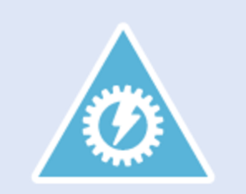
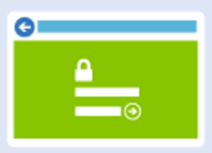
API Gateway with Azure API Management
Client mobile app
Back end
Azure API Management
Microservice 1
Web API
Developer portal
container
Microservice 2
Web API
API Gateway
container
Client SPA Web app
Microservice 3
Web API
Client WebApp MVC
ASP.NET Core MVC
container
Publisher portal
container
JavaScript/Angular.js

Slide 29
Preferred objections handling
There are many ways to deploy Docker containers on Azure. How do those options compare and what are motivations for each?
Web App for Containers – simple PaaS without full-featured container orchestration
Azure Container Instances – simple, isolated, without management tooling, enabling workload scale on demand
Azure Kubernetes Services (AKS) – the ideal solution for a fully managed experience
Notes:
The easiest way to move to containers on Azure is to deploy containers to the Linux variant of App Service. However this option does not provide a full-featured container orchestration platform with highly customizable load balancing, dynamic service discovery, and a holistic approach to container monitoring.
Azure Container Instances also provide a simple way to manage individual containers without management tooling providing a way to do on demand scaling for workloads that need that flexibility.
Ideally, Azure Kubernetes Service (AKS) will provide a fully managed service with the full set of orchestration and management tools. Working with AKS is the best choice to enable migration to AKS while still benefiting from a complete container orchestration experience to support the growth trajectory of the solution.

Slide 30
Preferred objections handling
Is there an option in Azure that provides container orchestration platform features that are easy to manage and migrate to, that can also handle our scale and management workflow requirements?
The best option is to go with a managed cluster such as Azure Container Service (AKS), native to Azure
Notes:
The best of all worlds is to go with a managed orchestration platform like AKS – native to Azure. It reduces the cost and management overhead of the cluster, while still providing a solution that supports growth, scale, and native management tooling.
With Kubernetes you will have additional features at your fingertips beyond the pure Docker approach including:
The Kubernetes management dashboard which includes web interface and remote APIs for managing, running, and scaling containers, including CICD integration options.
The kubectl command line tool for engaging remote Kubernetes APIs and assisting with automation.
Built-in dynamic service discovery simplifying the deployment of new container instances to a load balanced environment.

Slide 31
Customer quote
“With Azure Kubernetes Service (AKS) we feel confident we can make the move to a container-based platform with the right DevOps support in place to be successful with a small team.”
- Arthur Block, VP of Engineering at Fabrikam Medical Conferences

